Slide 1
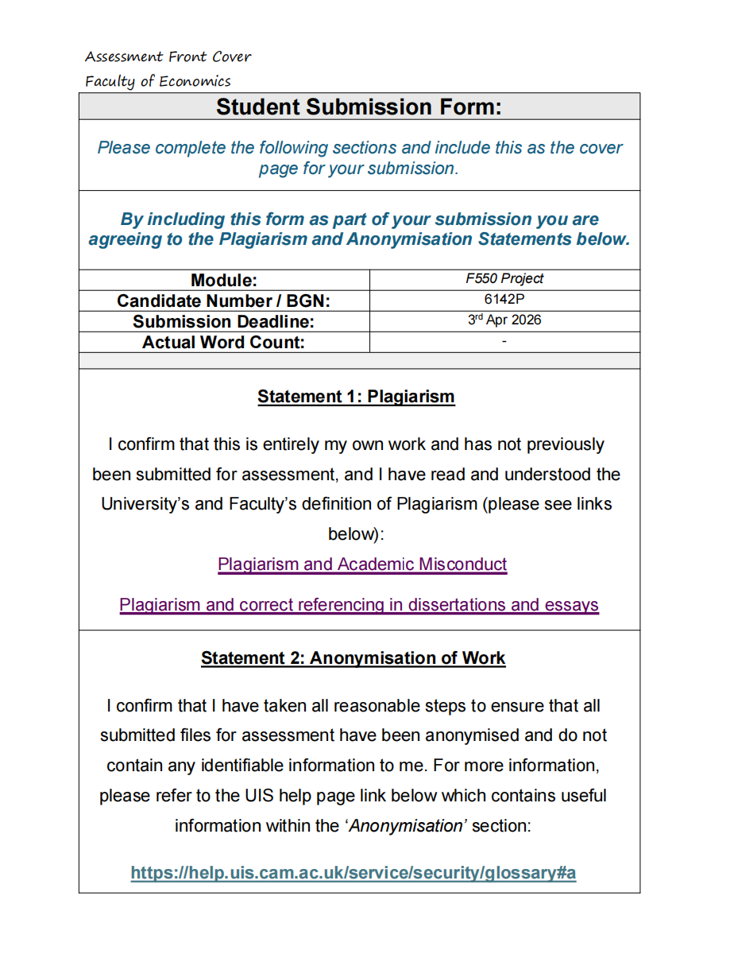

Slide 2
Application of AI in Finance
01
Sample Selection
Forward-Looking
Sentiment Indicators
178 companies · survivorship-bias corrected
02
Text Segmentation
60,305 forward-looking sentences
03
Three-Method Scoring
LM Lexicon · FinBERT · GPT Intensity
IT vs Industrials · S&P 500 · 2024
Exercise 1
04
Index Aggregation
Market-cap weighted · quarterly sector index
05
Analysis & Findings
Sub-sector · divergence · uncertainty
F550 Final Project · 2024

Slide 3
Sample Selection & Survivorship Bias
178
167
11
713
Total companies
in sample
Stable full-year
constituents
Removed companies
during 2024
Earnings call
transcripts
Data Source
Sample Selection Logic
LSEG (London Stock Exchange Group) Workspace / Eikon
• Earnings call transcripts filtered from Events module by time, event type, and industry
• Period: 01/01/2024 – 31/12/2024 (Q4 2023 – Q3 2024 reporting periods)
• GICS sub-industry labels (Level 3)
• Market cap for weighting
• All companies in ≥1 quarterly snapshot included
• Removal companies (11) retained → avoids survivorship bias
• Index rebalances treated as natural add/drop events
• Full-year stable companies form the core sample
Note
The sample covers all earnings calls held between 01/01/2024 and 31/12/2024, corresponding to Q4 2023 through Q3 2024 reporting periods.
This ensures full coverage of management forward-looking statements made during the calendar year 2024.
Period: Q4 2023 – Q3 2024 · Sectors: Information Technology · Industrials · Source: LSEG

Slide 4
Text Segmentation & Forward-Looking Extraction
Raw Transcript
Speaker Tagging
FL Sentence Extraction
Scored Dataset
PDF → text extraction
713 transcripts
178 companies
CEO/CFO → management
Analysts → analyst
Avg 26 mgmt + 17 analyst
segs / transcript (IT)
Keyword + syntactic rules
(will, expect, anticipate…)
Forward-looking only
Avg 84.6 FL sents / call
60,305 FL sentences
12,308 Guidance sentences
786 Removal sentences
Ready for scoring
Speaker Segmentation by Sector
Code
Two-pass filter: require FL trigger AND exclude backward-looking signals
Sector | Mgmt segs/call | Analyst segs/call | Companies
IT | 26.4 | 17.1 | ~90 (Semi, Software, IT Services, Hardware…)
Industrials | 31.7 | 22.1 | ~77 (Machinery, Aerospace, Airlines…)
Removal | 26.9 | 19.3 | 11 (survivorship bias control sample)
FL_RE = re.compile(
r"\b(will|expect|anticipate|forecast|outlook|guidance|"
r"going forward|next quarter|positioned to|pipeline)\b",
re.IGNORECASE
)
BL_RE = re.compile(
r"\b(last quarter|reported|delivered|achieved|"
r"year-over-year|quarter-over-quarter)\b",
re.IGNORECASE
)
def is_forward_looking(sentence):
bool(FL_RE.search(sentence)) and not bool(BL_RE.search(sentence))
FL = Forward-Looking · Segmentation via regex + syntactic parsing · Q4 2023 – Q3 2024

Slide 5
Three-Method Scoring Framework
LM Lexicon
FinBERT
GPT Intensity
Lexicon-based
Deep Learning
LLM Scoring
Loughran-McDonald finance dictionary
• Positive & Negative word lists
• Uncertainty word list (separate index)
• Score = (pos − neg) / total words
• Phrase-level negation handling
BERT fine-tuned on financial text
• Sentence-level classification
• Labels: positive / negative / neutral
• Context-aware (negations, hedges)
• Score averaged across FL sentences
GPT-4o scoring on 0–10 scale
• Continuous intensity output
• CEO vs analyst scored separately
• Tone intensity weighting variant
• Normalised to [0,1] for aggregation
✓ Transparent · domain-specific · fast
✓ Context-sensitive · state-of-art NLP
✓ Captures nuance · distinguishes tone strength
Code
Code
lm_score = (pos - neg) / (pos + neg + 1)
lm_unc = uncertainty_words / word_count
"score": 0–10 (0=bearish … 10=bullish)
"intensity": 1–3 (1=mild, 2=moderate, 3=emphatic)
LM: smoothed net score + uncertainty density
GPT: two-dimensional output (direction + intensity)
All three methods applied to the same FL sentence pool. Cross-method consistency validates robustness; divergences reveal analytical blind spots.
Minimum one lexicon-based method required per project spec · LM = Loughran-McDonald (2011)

Slide 6
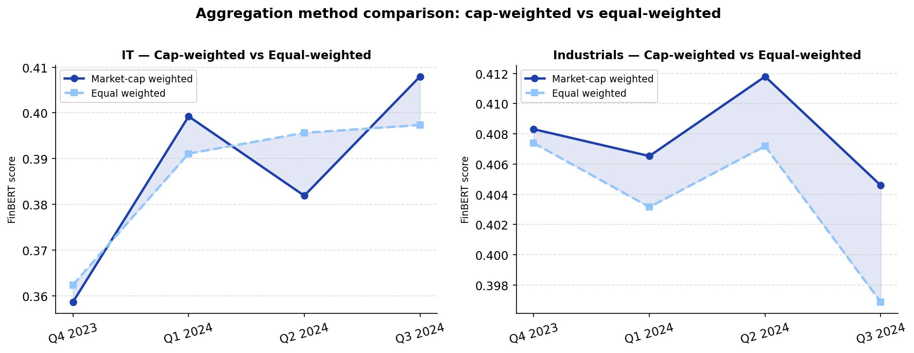
Aggregation Mechanism: Market-Cap vs Equal-Weighted
1
Sentence → Company Score
Average FL sentence score per company per quarter (by method)
2
Company → Sector Index
Market-cap weighted average across sector constituents
Parallel equal-weight index for comparison
3
Quarterly Sector Index
Two series per sector × three methods = 6 time series
Base period: Q4 2023
Fig 3 · Cap-weighted vs Equal-weighted (FinBERT)
Code
Key finding: Cap-weighted and equal-weighted indices track closely, suggesting no single mega-cap dominates sector sentiment. IT diverges slightly at Q1 2024 peak (NVDA effect).
if mask.sum()==0: return np.nanmean(v) # equal-wt
Fallback: equal-weight when market cap unavailable
Weighting formula: Σ(score_i × mcap_i) / Σ mcap_i · Market cap sourced from Bloomberg at quarter-end

Slide 7
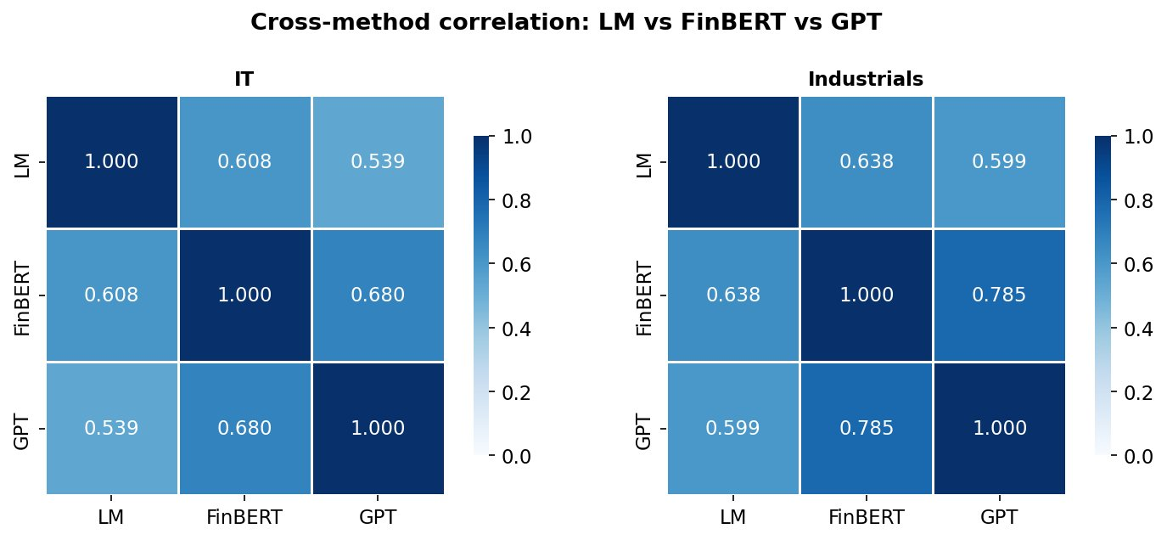
Cross-Method Validation & Divergence Analysis
Observations
Moderate agreement (r ≈ 0.54–0.68)
All methods agree on directional trend; moderate correlation confirms overlapping but non-identical signals.
LM lowest correlation
LM is word-frequency driven; misses contextual negations that FinBERT and GPT handle, lowering cross-method r.
Q2 2024 IT divergence
LM uptick vs FinBERT dip — AI regulation language inflated LM positive word count without conveying genuine optimism.
Industrials: higher consensus
Fig 7 · Cross-method correlation matrix (LM · FinBERT · GPT)
FinBERT–GPT r = 0.785 vs 0.680 in IT. Plainer industrial language yields better method agreement.
Conclusion: Complementary methods — consensus adds robustness; divergence is analytically informative, not noise.

Slide 8
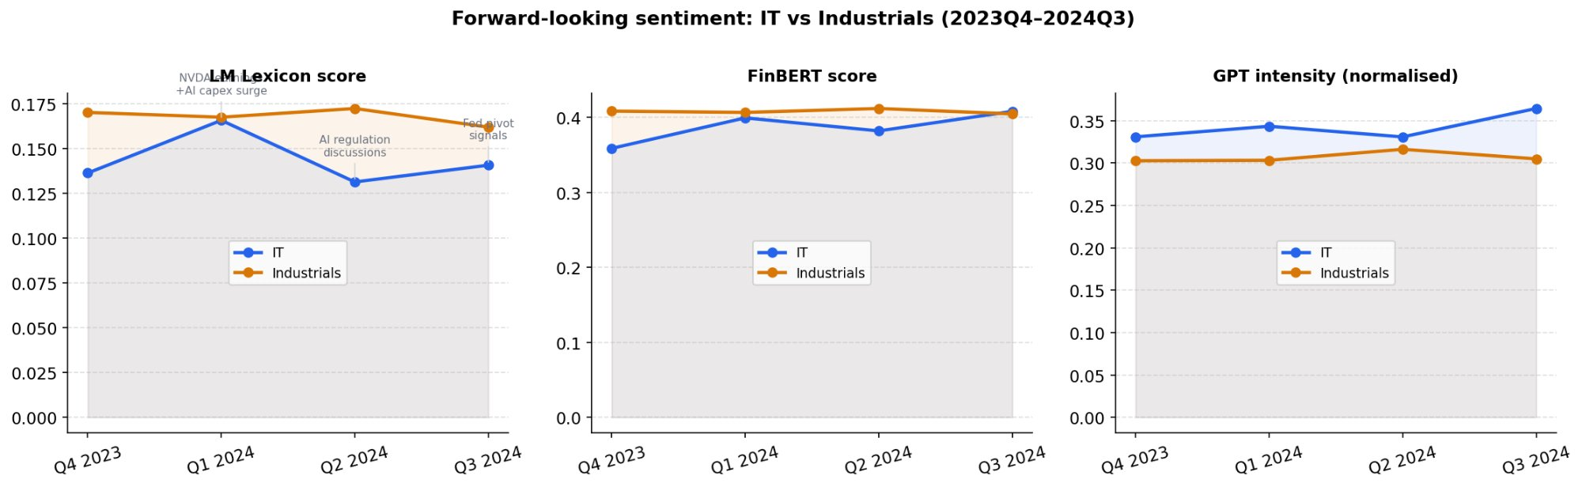
Main Results: Sector Sentiment Time Series
Macro Event Timeline
Q4 2023
AI capex surge; NVDA & hyperscalers drive IT optimism. Industrials start from higher base.
Q1 2024
NVDA earnings beat; IT sentiment peaks (all 3 methods). Industrials stable — Fed uncertainty.
Q2 2024
AI regulation discussions; LM inflated vs FinBERT dip (divergence). Industrials hold steady.
Fig 1 · Three-method forward-looking sentiment: IT vs Industrials (Q4 2023 – Q3 2024)
Q3 2024
Fed pivot signals; IT GPT & FinBERT rebound. Industrials edge down.
Key: IT sentiment more volatile and macro-reactive; Industrials more stable. Both sectors show positive forward-looking sentiment throughout 2024.
No statistical tests required per project spec · Findings based on visual inspection of quarterly indices

Slide 9
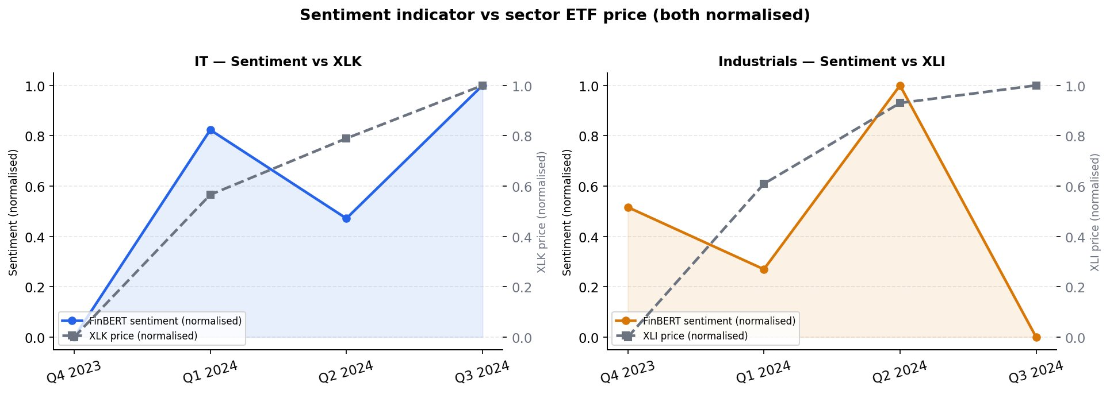
Sentiment Indicator vs Sector ETF Price
Fig 2 · Normalised FinBERT sentiment vs XLK (IT) and XLI (Industrials) ETF prices
IT (XLK): Alignment ✓
Industrials (XLI): Divergence ⚠
IT sentiment and XLK broadly co-move. Both rise to a joint peak in Q1 2024 coinciding with NVDA's earnings beat, pull back together in Q2 2024 amid AI regulation discussions, then converge again at the normalised high in Q3 2024.
Industrials sentiment peaks in Q2 2024 then drops sharply in Q3 2024 as earnings tone turns cautious on softening demand. XLI price keeps climbing on Fed rate-cut expectations. The two series move in opposite directions, a classic macro vs micro disconnect.
Both series normalised to [0,1] · Correlation shown for visual observation only — no causal claim made · ETF price: Yahoo Finance

Slide 10
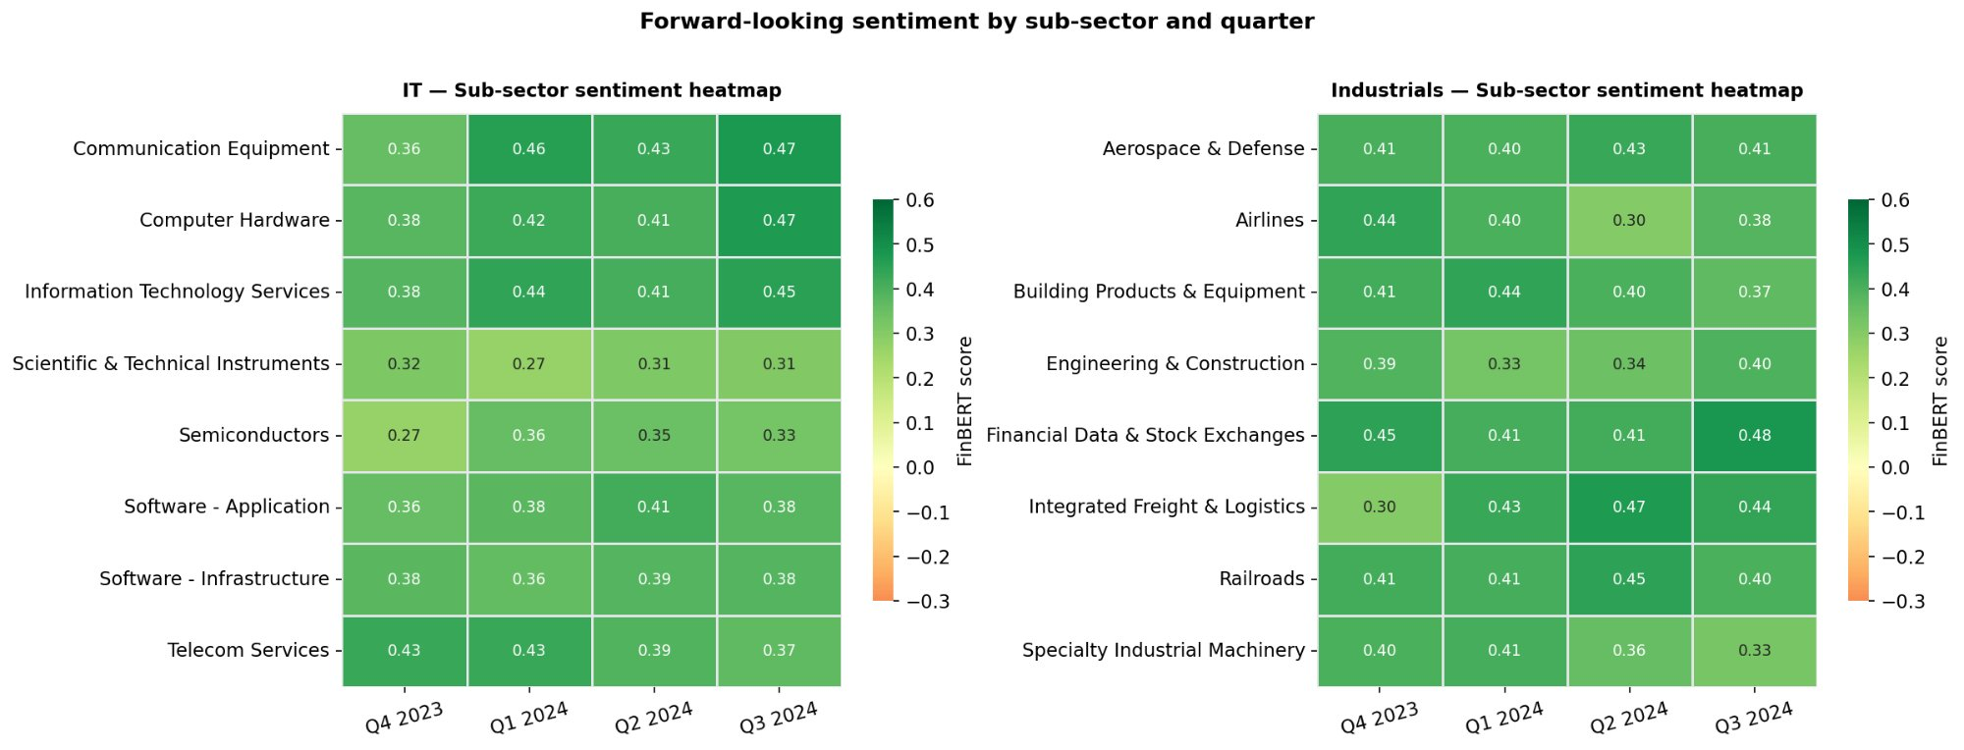
Sub-Sector Breakdown: Sentiment Heatmap
Fig 5 · Forward-looking FinBERT sentiment by sub-sector and quarter
Semiconductors (IT) — lowest absolute level but clear uptrend Q4→Q3, consistent with AI capex cycle
Airlines (Industrials) — sharp Q2 2024 drop: fuel cost / fare pressure language dominates FL sentences
Communication Equipment & Financial Data — consistently strong positive outlook across all quarters
GICS Level-3 sub-industry classification · Colour scale: green = more positive sentiment

Slide 11
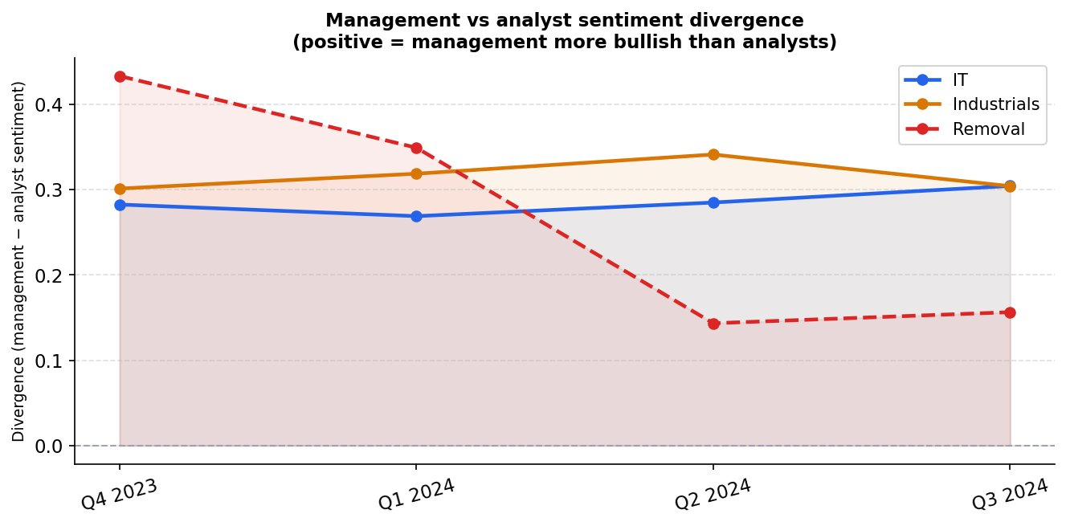
Management vs Analyst Sentiment Divergence
Key Insights
Management systematically more bullish
Positive divergence in all sectors and quarters, which is consistent with incentive to signal optimism.
Removal companies: largest divergence
Q4 2023 divergence ≈ 0.44; declines sharply as problems become apparent to both sides by Q2 2024.
IT divergence stable
IT management maintains moderate consistent gap — AI narrative allows sustained optimism vs cautious analysts.
Academic support
Consistent with Price & DeAngelo (1981): management has information advantage and positive reporting incentive.
Fig 4 · Divergence = management − analyst score
(positive = management more bullish than analysts)
Speaker tagging: CEO/CFO/COO = management · buy-side/sell-side = analyst · Divergence = method-averaged score difference

Slide 12
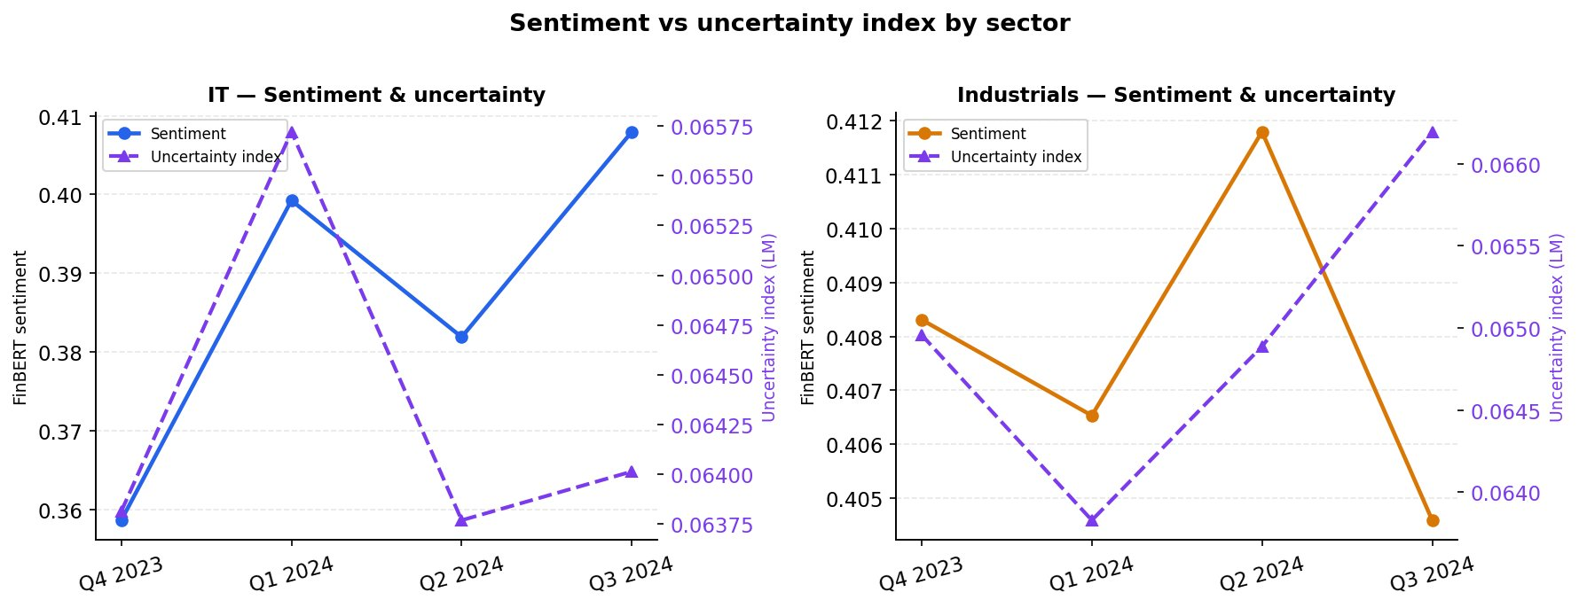
Uncertainty Index: Sentiment & Uncertainty Co-movement
Dual-Signal Reading
IT — Q1 2024
Sentiment peaks AND uncertainty high → 'optimistic but cautious'; AI opportunity real but path unclear.
IT — Q2 2024
Both drop together → reduced optimism AND reduced hedging; narrative consolidates.
Industrials — Q3 2024
Sentiment falls; uncertainty rises → cautious earnings outlook as costs & demand soften.
Industrials — Q1 2024
Fig 6 · FinBERT sentiment (left axis) vs LM uncertainty index (right axis, dashed)
Uncertainty trough while sentiment stable → highest conviction quarter for industrial mgmt.
Uncertainty index = LM uncertainty word count / total words · Measures hedging language density independently of sentiment direction

Slide 13
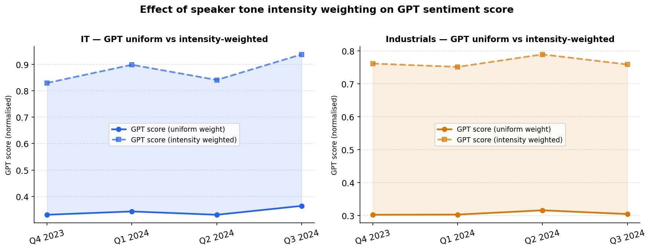
Speaker Tone Intensity Weighting
Method
Scoring GPT scores each FL sentence 0–10 for sentiment intensity
Weighted Formula Intensity-weighted avg = Σ(score × intensity) / Σ intensity
Fig 8 · GPT uniform weight vs intensity-weighted score (normalised)
Result Raises absolute level but preserves trend direction
Implication 1
Implication 2
Trend-preserving: intensity weighting does not reverse or alter directional signals.
Level-amplifying: higher absolute score → stronger separation between high and low conviction quarters.
GPT model: gpt-4o · Intensity scale: 0 (neutral) to 10 (very strong conviction) · Both variants normalised to [0,1]

Slide 14
Key Findings Summary
Information Technology
Industrials
More volatile sentiment — macro/AI news sensitive (NVDA Q1 2024 peak)
Higher base sentiment, more stable across quarters
LM and FinBERT diverge Q2 2024: regulation language inflates word counts
Airlines sub-sector: sharp Q2 drop — cost/demand language dominates
Semiconductors sub-sector lowest absolute level but clear uptrend
Q3 2024: ETF rises (Fed pivot) while sentiment falls — macro/micro split
High Q1 sentiment + high uncertainty = 'optimistic but cautious'
Higher cross-method consensus (FinBERT–GPT r=0.785 vs 0.680 in IT)
Cross-sector: Management consistently more bullish than analysts. Cap-weighted ≈ equal-weighted. Three methods broadly agree on direction.
All findings: visual inspection only — no statistical inference drawn per project specification

Slide 15
Limitations & Potential Improvements
Data Limitations
Method Limitations
Potential Improvements
Transcript availability gaps
LM dictionary staleness
Custom earnings-call BERT
Not all small-cap S&P 500 members publish full transcripts; some rely on press releases
LM built on pre-AI filings; AI-specific terms ('inference', 'hallucination') unscored
Fine-tune on earnings call corpora (e.g. FinText) for domain-specific accuracy
Survivorship bias (partial)
FinBERT domain shift
Higher-frequency data
Deeply distressed firms that stopped reporting mid-year may be underrepresented
Trained on news articles, not earnings calls; slight domain mismatch
Use 8-K filings and press releases to generate monthly sentiment index
Market cap timing
GPT cost & consistency
Named entity linking
Quarter-end weights used; intra-quarter float changes ignored
LLM scoring expensive at scale; minor run-to-run variation without seed control
Attach sentiment to specific products/regions mentioned in FL sentences
Single language
Quarterly aggregation
Statistical validation
Non-English forward guidance (rare ADRs) not handled
Monthly or event-driven frequency would better capture intra-quarter shifts
Granger causality / VAR testing against ETF returns to validate predictive signal

Slide 16
Exercise 2
LLM Fundamental
Valuation Agent
2
3
TTM Windows
Sentiment Methods
Feb & Aug 2024
LM · FinBERT · GPT
NVIDIA Corporation (NVDA) · Two TTM Windows · With vs Without Sentiment
+185%
2.18
01
TTM Valuation Metrics
Buy-and-Hold Return
B&H Sharpe Ratio
P/E · P/S · P/FCF
NVDA full-year 2024
Risk-free rate 5%
02
Sentiment Augmentation
LM · FinBERT · GPT (Ex.1)
03
GPT-4o Agent Decisions
Buy / Sell / Hold + Thesis
04
Backtesting & Sharpe
Yahoo Finance price data
05
Findings & Limitations
Qualitative & quantitative
F550 Application of AI in Finance · Exercise 2 · NVDA Valuation Agent · 2024

Slide 17
Framework & Methodology
TA-Class LLM Fundamental Agent
Market Data
TTM Fundamentals
Sentiment (Ex.1)
GPT-4o Agent
Backtester
📊
📋
💬
🤖
📈
yfinance
yfinance quarterly
LM Lexicon score
RAG filing context
Event-driven
251 trading days
Revenue · Net Income
FinBERT score
With / without
2 decision points
2024-01-01 to
OCF · CapEx · FCF
GPT intensity (0–10)
sentiment prompt
Sharpe Ratio
2024-12-30
P/S · P/E · P/FCF
2023Q4 & 2024Q2
Buy · Sell · Hold
vs B&H benchmark
Window 1 — February 2024
Window 2 — August 2024
05/02/2024 – 10/02/2024
05/08/2024 – 10/08/2024
Sentiment: 2023Q4 earnings call (filed 2024-02-21)
Sentiment: 2024Q2 earnings call (filed 2024-08-28)
NVDA price: $70.10 · P/E: 14.19 · P/S: 7.89 · P/FCF: 17.62
NVDA price: $98.91 · P/E: 20.02 · P/S: 11.14 · P/FCF: 24.86
Data sources: Yahoo Finance (prices) · yfinance quarterly financials (fundamentals) · Exercise 1 NLP pipeline (sentiment) · OpenAI GPT-4o

Slide 18
TTM Valuation Metrics & Sentiment Inputs
Point-in-time data for both windows
Point-in-Time TTM Valuation Metrics
Sentiment Inputs (from Exercise 1)
Metric | Window 1 (Feb 2024) | Window 2 (Aug 2024)
Price | $70.10 | 98.91
TTM Revenue | $60.98 | 96.38
TTM Net Income | $29.88 | 55.38
TTM FCF | $27.08 | 49.68
P/S | 7.89 | 11.14
P/E | 14.19 | 20.02
P/FCF | 17.62 | 24.86
Window 1 · 2023Q4 Earnings Call
LM Lexicon
0.0748
FinBERT
0.3265
GPT Intensity
6.81 / 10
Window 2 · 2024Q2 Earnings Call
LM Lexicon
0.0316
FinBERT
0.3650
GPT Intensity
6.61 / 10
✓ = within agent cheap threshold range · Fundamentals via yfinance (NVDA FY ends Jan 31)
Key Observation:
Window 2 shows higher FinBERT score (0.365 vs 0.327) despite lower LM score (0.032 vs 0.075), highlighting FinBERT better captures AI-specific bullish language ('Blackwell demand exceeds supply', 'sovereign AI') that LM lexicon misses due to pre-AI vocabulary. Both windows reflect moderately positive management tone, consistent with strong but supply-constrained AI demand narrative.

Slide 19
Agent Decisions — With vs Without Sentiment
GPT-4o output at each TTM window
Window
WITHOUT Sentiment
WITH Sentiment
Window 1
Feb 2024
$70.10
P/E 14.19
HOLD
conf=0.65 score=+0.50
HOLD
conf=0.65 score=+0.30
NVDA fairly valued; P/E 14.19 and P/FCF 17.62 are reasonable given strong profitability. Positive price momentum (+11.2% over 5 days) suggests market optimism, but high P/FCF limits further upside.
Valuation multiples reasonable with P/E 14.19. FinBERT score of 0.3265 supports stable outlook, but recent 11.2% price increase may already price in the positive sentiment — maintain caution.
Window 2
Aug 2024
$98.91
P/E 20.02
HOLD
conf=0.60 score=+0.20
HOLD
conf=0.60 score=+0.10
P/E 20.02 and P/FCF 24.86 indicate fair value relative to strong profitability. Recent price decline of 9.4% is negative momentum. Robust revenue growth is a positive, but supply constraints for Blackwell pose near-term risk.
Valuation multiples relatively high but justified by strong AI revenue growth. Positive FinBERT (0.365) and GPT intensity (6.61) reflect management confidence in Blackwell ramp. Price decline of 9.4% and high multiples warrant cautious hold.
Key: Both agents consistently output HOLD across both windows. Adding sentiment enriched the thesis narrative (referencing FinBERT/GPT scores) but did not alter the final signal. Hence, moderately positive sentiment was insufficient to override valuation-based caution.

Slide 20
Backtest Performance & Sharpe Ratio
Event-driven agent vs Buy-and-Hold benchmark
WITHOUT Sentiment
WITH Sentiment
Buy-and-Hold Benchmark
+0.00%
+0.00%
+185.44%
Total Return
Total Return
Total Return
Sharpe: N/A
Sharpe: N/A
Sharpe: 2.18
No trades executed
No trades executed
Passive full-year 2024
Return Comparison
WITHOUT Sentiment
+0.00%
WITH Sentiment
+0.00%
Buy-and-Hold
+185.44%
Backtest config: Initial capital $100,000 · Transaction cost 10bps · 5 shares per trade · Short selling enabled · Risk-free rate 5% annualised

Slide 21
Key Findings, Limitations & Improvements
Critical discussion
Finding 01
Finding 02
Finding 03
Fundamental agents underperform on momentum-driven stocks
Sentiment enriches reasoning but does not change decisions
Data integrity: fiscal year mismatch in XBRL pipeline
Both agents output HOLD throughout 2024 while Buy-and-Hold returned +185.44% (Sharpe 2.18). Traditional multiples (P/E, P/FCF) fail to capture the AI-driven growth premium embedded in NVDA's price, leading to systematic under-action during a hyper-growth cycle.
Adding earnings-call sentiment shifted the thesis from purely quantitative to qualitatively richer, explicitly referencing FinBERT and GPT scores. However, moderately positive sentiment (~0.33–0.37 FinBERT) was insufficient to override valuation-based caution. A higher sentiment threshold for triggering action may be needed.
NVDA's non-standard fiscal year (ends Jan 31) caused SEC EDGAR XBRL revenue tags to return NaN. Switching to yfinance quarterly financials resolved this, highlighting the importance of source validation in automated pipelines. P/E and P/FCF were successfully computed for both windows.
Limitations
Potential Improvements
▪ Only 2 decision points, Sharpe Ratio estimation is not robust with sparse signals
▪ RAG context limited to manual snippets, not full 10-Q filing texts
▪ Single ticker, findings may not generalise beyond NVDA's exceptional 2024 context
▪ Add PEG ratio or forward P/E to capture growth-adjusted valuation for AI stocks
▪ Calibrate sentiment thresholds, trigger BUY only above a minimum FinBERT score
▪ Expand to multi-quarter decision points and integrate full 10-Q filings via RAG

Slide 22
Appendix - Exercise 1 Code Structure
** Double-click the Doc image to get the code.
File | Doc | Role
step1_data_collection.py |  | -
step2_parse_transcripts.py |  | Parse earnings call PDFs into structured JSON, tagging each segment by speaker type (management / analyst) and section.
step3_forward_looking.py |  | Extract forward-looking sentences using a two-pass filter, and compute LM lexicon scores per sentence.
step4_sentiment_scoring.py |  | Score all forward-looking sentences with three methods: LM net sentiment, FinBERT classification, and GPT-4o intensity scoring (0–10).
step5_aggregation.py |  | Aggregate sentence-level scores to company-quarter and sector-quarter indices (market-cap weighted), and compute management vs analyst divergence and uncertainty index.
step6_visualization.py |  | Generate all 8 output figures from aggregated data, covering sentiment trends, ETF overlay, sub-sector heatmap, divergence, and cross-method validation.

Slide 23
Appendix - Exercise 2 Code Structure
Files modified and used unchanged from the original TA-class framework:
File | Doc | Role | Modified
valuation_agent.py |  | Core agent: computes TTM metrics, builds prompt, calls GPT-4o, returns Buy/Sell/Hold + thesis | Added sentiment_scores, recent_prices fields; two prompt variants (with/without sentiment)
backtester.py |  | Event-driven backtest engine: executes trades on signal dates, tracks portfolio value | Added compute_sharpe() and print_summary()
main.py |  | Orchestrator: loads data, runs both agent versions, prints comparison | Replaced SEC EDGAR with yfinance (NVDA FY mismatch); added sentiment inputs, B&H benchmark
llm_backend.py |  | OpenAI API wrapper for chat completions and embeddings | Unchanged
market_data.py |  | Fetches NVDA price series via yfinance | Unchanged
filing_rag.py |  | Chunks, embeds, and retrieves filing text for RAG context | Unchanged
sec_fundamentals.py |  | SEC EDGAR XBRL fetcher and TTM calculator | Unchanged (not used for NVDA)
External data inputs: sentiment_scores (hardcoded in main.py), sourced from Exercise 1 NLP pipeline; 2023Q4 scores used for Window 1, 2024Q2 scores used for Window 2.

